Slide 1
The software requirements document

Slide 2
The software requirements document
The software requirements document is the official statement of what is required of the system developers.
Should include both a definition of user requirements and a specification of the system requirements.
It is NOT a design document. As far as possible, it should set of WHAT the system should do rather than HOW it should do it.

Slide 3
Agile methods and requirements
Many agile methods argue that producing a requirements document is a waste of time as requirements change so quickly.
The document is therefore always out of date.
Methods such as XP use incremental requirements engineering and express requirements as ‘user stories’.
This is practical for business systems but problematic for systems that require a lot of pre-delivery analysis (e.g. critical systems) or systems developed by several teams.

Slide 4
Users of a requirements document

Slide 5
Requirements document variability
Information in requirements document depends on type of system and the approach to development used.
Requirements documents standards have been designed e.g. IEEE standard. These are mostly applicable to the requirements for large systems engineering projects.

Slide 6
Requirements Document
Naturally, the information that is included in a requirements document depends on the type of software being developed and the approach to development that is to be used.

Slide 7
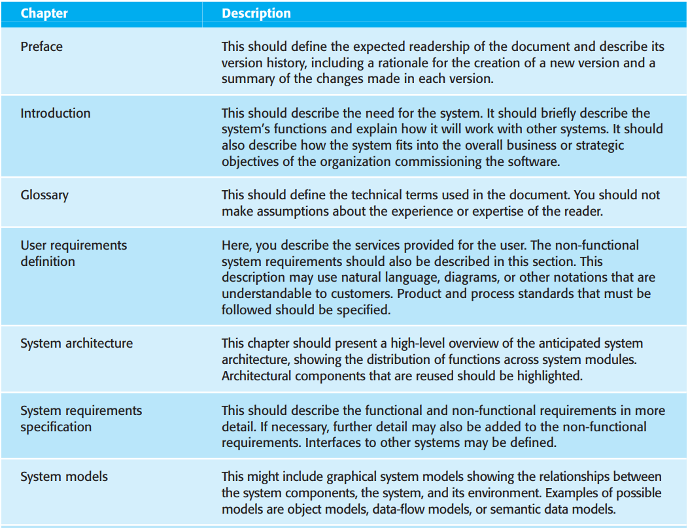
The structure of a requirements document

Slide 8
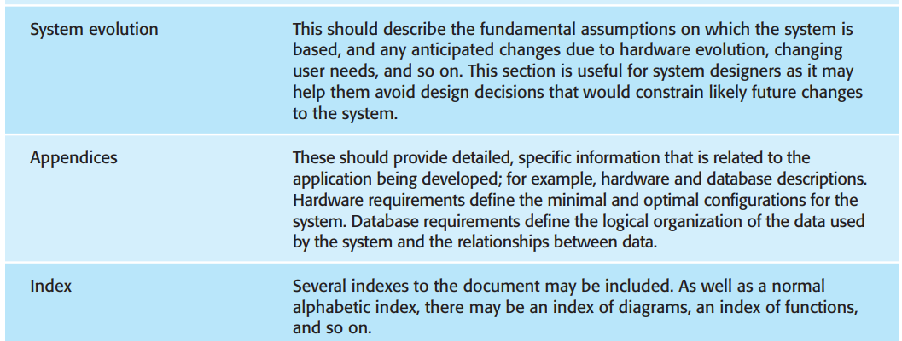

Slide 9
Requirements specification
The process of writing down the user and system requirements in a requirements document.
User requirements have to be understandable by end-users and customers who do not have a technical background.
System requirements are more detailed requirements and may include more technical information.
The requirements may be part of a contract for the system development
It is therefore important that these are as complete as possible.

Slide 10
Ways of writing a system requirements specification
Notation | Description
Natural language | The requirements are written using numbered sentences in natural language. Each sentence should express one requirement.
Structured natural language | The requirements are written in natural language on a standard form or template. Each field provides information about an aspect of the requirement.
Graphical notations | Graphical models, supplemented by text annotations, are used to define the functional requirements for the system; UML use case and sequence diagrams are commonly used.
Mathematical specifications | These notations are based on mathematical concepts such as finite-state machines or sets. Although these unambiguous specifications can reduce the ambiguity in a requirements document, most customers don’t understand a formal specification. They cannot check that it represents what they want and are reluctant to accept it as a system contract

Slide 11
Example requirements for the insulin pump software system
3.2 The system shall measure the blood sugar and deliver insulin, if required, every 10 minutes. (Changes in blood sugar are relatively slow so more frequent measurement is unnecessary; less frequent measurement could lead to unnecessarily high sugar levels.) 3.6 The system shall run a self-test routine every minute with the conditions to be tested and the associated actions defined in Table 1. (A self-test routine can discover hardware and software problems and alert the user to the fact the normal operation may be impossible.)

Slide 12
Guidelines for writing requirements
Invent a standard format and use it for all requirements.(single sentence!!)
Use language in a consistent way. Use shall for mandatory requirements, should for desirable requirements.
Use text highlighting to identify key parts of the requirement.
Avoid the use of computer jargon (specialised words).
Include an explanation (rationale) of why a requirement is necessary.

Slide 13
Problems with natural language
Lack of clarity
it is sometimes difficult to use language in a precise and unambiguous way, without making the document wordy and difficult to read
Requirements confusion
Functional, non-functional requirements and design information tend to be mixed-up.
Requirements amalgamation
Several different requirements may be expressed together in a single requirement.

Slide 14
Ways of writing a system requirements specification
Notation | Description
Natural language | The requirements are written using numbered sentences in natural language. Each sentence should express one requirement.
Structured natural language | The requirements are written in natural language on a standard form or template. Each field provides information about an aspect of the requirement.
Graphical notations | Graphical models, supplemented by text annotations, are used to define the functional requirements for the system; UML use case and sequence diagrams are commonly used.
Mathematical specifications | These notations are based on mathematical concepts such as finite-state machines or sets. Although these unambiguous specifications can reduce the ambiguity in a requirements document, most customers don’t understand a formal specification. They cannot check that it represents what they want and are reluctant to accept it as a system contract

Slide 15
Structured specifications
An approach to writing requirements where the freedom of the requirements writer is limited and requirements are written in a standard way.
This works well for some types of requirements
e.g. requirements for embedded control system but is sometimes too rigid for writing business system requirements.

Slide 16
Form-based specifications
Definition of the function.
Description of inputs and where they come from.
Description of outputs and where they go to.
Description of the action to be taken.
Pre and post conditions (if appropriate).
The side effects (if any) of the function.

Slide 17
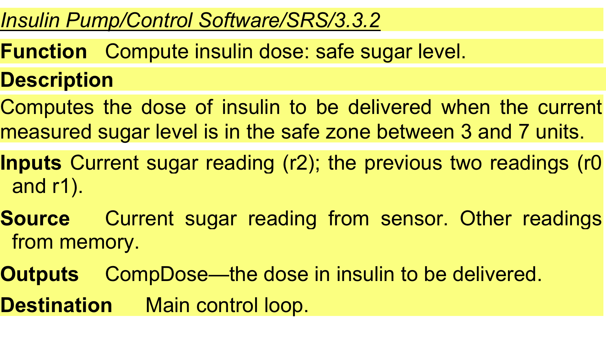
A structured specification of a requirement for an insulin pump

Slide 18
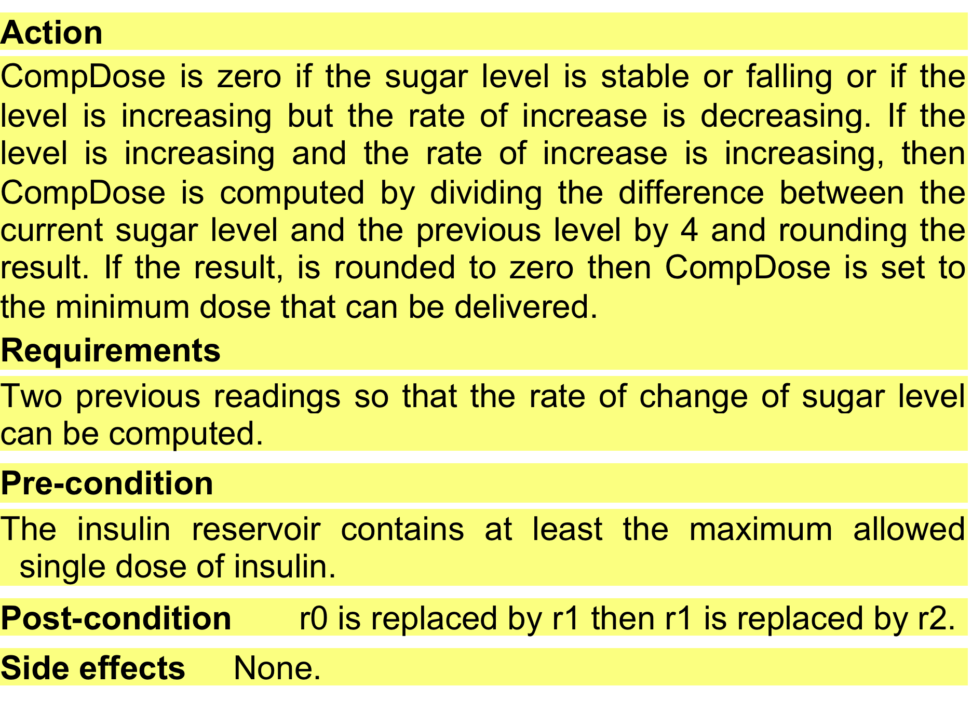
A structured specification of a requirement for an insulin pump

Slide 19
Ways of writing a system requirements specification
Notation | Description
Natural language | The requirements are written using numbered sentences in natural language. Each sentence should express one requirement.
Structured natural language | The requirements are written in natural language on a standard form or template. Each field provides information about an aspect of the requirement.
Graphical notations | Graphical models, supplemented by text annotations, are used to define the functional requirements for the system; UML use case and sequence diagrams are commonly used.
Mathematical specifications | These notations are based on mathematical concepts such as finite-state machines or sets. Although these unambiguous specifications can reduce the ambiguity in a requirements document, most customers don’t understand a formal specification. They cannot check that it represents what they want and are reluctant to accept it as a system contract

Slide 20
Tabular specification
Used to supplement natural language.
Particularly useful when you have to define a number of possible alternative courses of action.
For example, the insulin pump systems bases its computations on the rate of change of blood sugar level and the tabular specification explains how to calculate the insulin requirement for different scenarios.

Slide 21
Tabular specification of computation for an insulin pump
Condition | Action
Sugar level falling (r2 < r1) | CompDose = 0
Sugar level stable (r2 = r1) | CompDose = 0
Sugar level increasing and rate of increase decreasing ((r2 – r1) < (r1 – r0)) | CompDose = 0
Sugar level increasing and rate of increase stable or increasing ((r2 – r1) ≥ (r1 – r0)) | CompDose = round ((r2 – r1)/4) If rounded result = 0 then CompDose = MinimumDose

Slide 22
Requirements engineering processes
The processes used for RE vary widely depending on the application domain, the people involved and the organisation developing the requirements.
However, there are a number of generic activities common to all processes
Requirements elicitation;
Requirements analysis;
Requirements validation;
Requirements management.
In practice, RE is an iterative activity in which these processes are interleaved.

Slide 23
Requirements elicitation and analysis
software engineers work with customers and system end-users to find out about the application domain, what services the system should provide, the required performance of the system, and hardware constraints.
May involve end-users, managers, engineers involved in maintenance, domain experts, etc. These are called stakeholders.

Slide 24
Requirements elicitation and analysis process activities

Slide 25
Requirements Elicitation and Analysis Process activities
Requirements discovery
Interacting with stakeholders to discover their requirements. Domain requirements are also discovered at this stage.
Requirements classification and organisation
Groups related requirements and organises them into coherent clusters.
Prioritisation and negotiation
Prioritising requirements and resolving requirements conflicts.
Requirements specification
Requirements are documented and input into the next round of iteration.

Slide 26
Problems of requirements analysis
Stakeholders don’t know what they really want.
Stakeholders express requirements in their own terms. Requirements engineers, without experience in the customer’s domain, may not understand these requirements.
Different stakeholders may have conflicting requirements. Requirements engineers have to discover all potential sources of requirements and discover commonalities and conflict.
Organisational and political factors may influence the system requirements. Managers may demand specific system requirements because these will allow them to increase their influence in the organization.
The requirements change during the analysis process. New stakeholders may emerge and the business environment may change.

Slide 27
Requirement discovery
The process of gathering information about the required and existing systems and extracting the user and system requirements from this information.
Sources of information during the requirements discovery phase include documentation, system stakeholders, and specifications of similar systems.
Systems normally have a range of stakeholders.

Slide 28
Stakeholders in the MHC-PMS
Patients whose information is recorded in the system.
Doctors who are responsible for assessing and treating patients.
Nurses who coordinate with doctors and administer some treatments.
Medical receptionists who manage patients’ appointments.
IT staff who are responsible for installing and maintaining the system.

Slide 29
Stakeholders in the MHC-PMS
A medical ethics manager who must ensure that the system meets current ethical guidelines for patient care.
Health care managers who obtain management information from the system.
Medical records staff who are responsible for ensuring that system information can be maintained and preserved, and that record keeping procedures have been properly implemented.

Slide 30
Interviewing
Formal or informal interviews with stakeholders are part of most RE processes.
Types of interview
Closed interviews based on pre-determined list of questions
Open interviews where there is no predefined agenda. Various issues are explored with stakeholders.
Effective interviewing
Be open-minded, avoid pre-conceived ideas about the requirements and are willing to listen to stakeholders.
Prompt the interviewee to get discussions going using a requirements proposal, or by working together on a prototype system.

Slide 31
Interviews in practice
Normally a mix of closed and open-ended interviewing.
Interviews are good for getting an overall understanding of what stakeholders do and how they might interact with the system.
Interviews are not good for understanding domain requirements
Requirements engineers cannot understand specific domain terminology; It is impossible for stakeholders to discuss domain requirements without using this terminology.
Some domain knowledge is so familiar that people find it hard to articulate or think that it isn’t worth articulating.
For a librarian, it goes without saying that all purchases are arranged before they are added to the library.

Slide 32
Scenarios
Scenarios are real-life examples of how a system can be used.
They should include
A description of the starting situation;
A description of the normal flow of events;
A description of what can go wrong;
Information about other concurrent activities;
A description of the state when the scenario finishes.

Slide 33
Scenario for collecting medical history in MHC-PMS

Slide 34
Scenario for collecting medical history in MHC-PMS

Slide 35
Use cases
Use-cases are a scenario based technique in the UML which identify the actors in an interaction and the interaction itself.
A set of use cases should describe all possible interactions with the system.
High-level graphical model supplemented by more detailed tabular description.
Sequence diagrams may be used to add detail to use-cases by showing the sequence of event processing in the system.

Slide 36
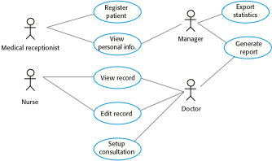
Use cases for the MHC-PMS

Slide 37
Description of the Setup Consultation use case
Setup consultation allows two or more doctors, working in different offices, to view the same record at the same time. One doctor initiates the consultation by choosing the people involved from a drop-down menu of doctors who are online. The patient record is then displayed on their screens but only the initiating doctor can edit the record. In addition, a text chat window is created to help coordinate actions. It is assumed that a phone conference for voice communication will be separately set up.

Slide 38
Ethnography
People often find it very difficult to explain how they carry out their routine tasks and how they work together in particular situation.
How to tie a shoelace?
Difficult to describe but easy to demonstrate process
Observation is a better way of understanding this type of tasks to understand what support people need from a computer-based system
Ethnography is an observational technique that can be used to understand operational processes and help derive requirements for these processes.
A social scientist spends a considerable time observing and analysing how people actually work.

Slide 39
Ethnography
People do not have to explain or articulate their work.
Ethnographic studies have shown that work is usually richer and more complex than suggested by simple system models.
For example, observing workers in a bank to understand their everyday work and hence derive requirements for computer support.
Ethnography studies cannot be carried out according to a formula
They are dependent on the personality of ethnographer
The type of process being studied
People involved in the process
To be effective, the ethnographer must be accepted by the people being studied
The people must feel comfortable to carry on their daily tasks in the presence of ethnographer.

Slide 40
Ethnography study process
Assume that people you are studying are good at doing their jobs and look for non-standard ways of working.
These often points to the efficiencies which has been introduced through individual experiences
It is important to spend time getting to know people involved and establish a relationship of trust.
For this reason, ethnography is best carried out by an external organization.
Detailed notes of all work practices should be made during the observation and written up on regular basis.
The ethnographer must analyze the notes and draw conclusions from them.
Open ended interviewing can be combined with ethnography to develop an understanding of what is going on.

Slide 41
Scope of ethnography
Requirements that are derived from the way that people actually work, rather than the way in which process definitions suggest that they ought to work.
Requirements that are derived from cooperation and awareness of other people’s activities.
Ethnography is effective for understanding existing processes but cannot identify new features that should be added to a system.

Slide 42
Requirements validation
Requirements validation is the process of checking that requirements actually define the system that the customer really wants.
Requirements error costs are high so validation is very important
Fixing a requirements error after delivery may cost up to 100 times the cost of fixing an implementation error.

Slide 43
Requirements validation checking
Validity
Does the system provide the functions which best support the customer’s needs?
A user may think that a system is needed to perform certain functions. However, further analysis may identify additional or different functions that are required
Consistency
Requirements in the document should not conflict.
That is, there should not be contradictory constraints or different descriptions of the same system function.
Completeness
The requirements document should include requirements that define all functions and the constraints intended by the system user.

Slide 44
Requirements validity checking
Realism
Using knowledge of existing technology, the requirements should be checked to ensure that they can actually be implemented. These checks should also take account of the budget and schedule for the system development.
Verifiability
To reduce the potential for dispute between customer and contractor, system requirements should always be written so that they are verifiable.
This means that you should be able to write a set of tests that can demonstrate that the delivered system meets each specified requirement.

Slide 45
Requirements validation techniques
Requirements reviews
The requirements are analyzed systematically by a team of reviewers who check for errors and inconsistencies.
Both client and contractor staff should be involved in reviews.
Prototyping
Using an executable model of the system to check requirements.
Client can experiment with this model to see if it meets their real needs.
Test-case generation
Developing tests for requirements to check testability.
If a test is difficult or impossible to design, this usually means that the requirements will be difficult to implement and should be reconsidered.

Slide 46
Requirements management
Requirements management is the process of managing changing requirements during the requirements engineering process and system development.
New requirements emerge as a system is being developed and after it has gone into use.
You need to keep track of individual requirements and maintain links between dependent requirements so that you can assess the impact of requirements changes.
You need to establish a formal process for making change proposals and linking these to system requirements.

Slide 47
Changing requirements
The business and technical environment of the system always changes after installation.
New hardware may be introduced, it may be necessary to interface the system with other systems, business priorities may change, and new legislation and regulations may be introduced that the system must necessarily abide by.
The people who pay for a system and the users of that system are rarely the same people.
System customers impose requirements because of organizational and budgetary constraints. These may conflict with end-user requirements and, after delivery, new features may have to be added for user support if the system is to meet its goals.

Slide 48
Changing requirements
Large systems usually have a diverse user community, with many users having different requirements and priorities that may be conflicting.
The final system requirements are inevitably a compromise between them and, with experience, it is often discovered that the balance of support given to different users has to be changed.

Slide 49
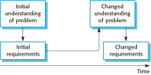
Requirements evolution

Slide 50
Requirements management planning
Establishes the level of requirements management detail that is required.
During the requirements management planning, you have to decide on:
Requirements identification Each requirement must be uniquely identified so that it can be cross-referenced with other requirements.
A change management process This is the set of activities that assess the impact and cost of changes.
Traceability policies These policies define the relationships between each requirement and between the requirements and the system design that should be recorded.
Tool support Tools that may be used range from specialist requirements management systems to spreadsheets and simple database systems.

Slide 51
Requirements change management stages
Deciding if a requirements change should be accepted
Problem analysis and change specification
During this stage, the problem or the change proposal is analyzed to check that it is valid. This analysis is fed back to the change requestor who may respond with a more specific requirements change proposal or decide to withdraw the request.
Change analysis and costing
The effect of the proposed change is assessed using traceability information and general knowledge of the system requirements.
The cost of making the change is estimated both in terms of modifications to the requirements document and, if appropriate, to the system design and implementation.
Once this analysis is completed, a decision is made whether or not to proceed with the requirements change.

Slide 52
Requirements change management stages
Change implementation
The requirements document and, where necessary, the system design and implementation, are modified.
You should organize the requirements document so that you can make changes to it without extensive rewriting or reorganization.
Changeability in documents is achieved by minimizing external references and making the document sections as modular as possible.

Slide 53

Requirements change management

Slide 54
Key points
You can use a range of techniques for requirements elicitation including interviews, scenarios, use-cases and ethnography.
Requirements validation is the process of checking the requirements for validity, consistency, completeness, realism and verifiability.
Business, organizational and technical changes inevitably lead to changes to the requirements for a software system. Requirements management is the process of managing and controlling these changes.

